Slide 1

Heat it or Cool it – ITZ FUZZY
Group Members-
Amit Bhojwani
Avanti Narayanan
Keta Amichandwala
Murtaza Dhuliawala

Slide 2
INTRODUCTION
Fuzzy logic is a form of probabilistic logic.
It deals with reasoning that is approximate rather than fixed and exact.
Fuzzy logic variables may have a truth value that ranges in degree between 0(false) and 1(true).
It incorporates a simple, rule-based IF X AND Y THEN Z approach to solving a control problem.
for eg. If water is too cold while taking a shower, you tend to move the valve towards hot water!

Slide 3
APPLICATION OF FUZZY LOGIC
FL lends itself to implementation in systems ranging from simple, small,embedded micro-controllers to large, networked, multi-channel PC or control systems.
In air conditioners, dehumidification and temperature decrease goes hand in hand. However, the complex interactions between user preferences, room temperature and humidity level are very difficult to achieve mathematically. FL provides a solution for the same!
FL is also used in washing machines, where the length of wash is determined by the volume of clothes and dirt. There was no suitable alternative to personal trial and error.

Slide 4
Problem Description
We are implementing a temperature controller system using fuzzy logic.
This controller can be applied to any system which we need to maintain at a particular temperature!

Slide 5
The Fuzzy temperature controller will make use of two parameters :
2. Instantaneous temperature of the system(Temp).
1. Constant temperature as per the requirement(Cmd)

Slide 6
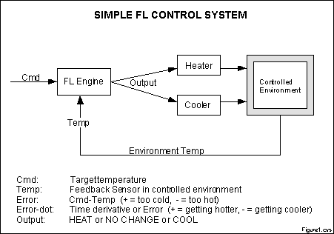
BLOCK DIAGRAM

Slide 7
Continued…
If Temperature
Is cold
Then heat
IF Temperature
IS normal
Then maintain level
Then cool
IS hot
IF Temperature

Slide 8
CONCEPTUAL DESIGN
In our implementation, fuzzy parameters of error (Cmd-Temp) and error-dot (rate-of-change-of-error) are modified by the adjectives "negative", "zero", and "positive".
For a meaningful interpretation of the rule matrix, we use the following notations :
"C" = "Cool" output response
"-" = "No Change" to current output
"H" = "Heat" output response
"P" = "positive" error or error-dot input level
"Z" = "zero" error or error-dot input level
"N" = "negative" error or error-dot input level

Slide 9
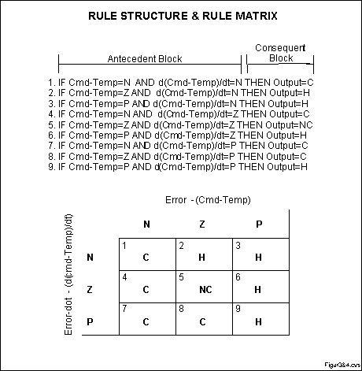
THE RULE MATRIX
A rule matrix is a 3x3 matrix.
The columns represent "negative", "zero", and "positive" "error" inputs from left to right.
The rows represent "negative", "zero", and "positive" "error-dot" input from top to bottom.

Slide 10
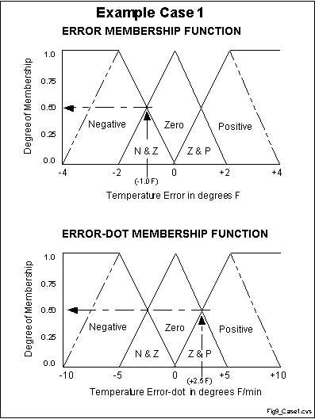
INPUT DEGREE OF MEMBERSHIP
1. If (e < 0) AND (er < 0) then Cool 0.50 & 0.00 = 0.00
2. If (e = 0) AND (er < 0) then Heat 0.50 & 0.00 = 0.00
3. If (e > 0) AND (er < 0) then Heat 0.00 & 0.00 = 0.00
4. If (e < 0) AND (er = 0) then Cool 0.50 & 0.50 = 0.50
5. If (e = 0) AND (er = 0) then No_Chng 0.50 & 0.50 = 0.50
6. If (e > 0) AND (er = 0) then Heat 0.00 & 0.50 = 0.00
7. If (e < 0) AND (er > 0) then Cool 0.50 & 0.50 = 0.50
8. If (e = 0) AND (er > 0) then Cool 0.50 & 0.50 = 0.50
9. If (e > 0) AND (er > 0) then Heat 0.00 & 0.50 = 0.00
"error" = -1.0: "negative" = 0.5, "zero" = 0.5, "positive" = 0.0
"error-dot" = +2.5: "negative" = 0.0, "zero" = 0.5, "positive" = 0.5

Slide 11
INTERFERENCING
From the last slide we infer,
Rules 4,5,7,8 were fixed at 50% or 0.5.
Rules 1,2,3,6,9 did not fire at all.
Therefore, we can notice all rules that fired were cooling or producing no change.
DIFFERENT TYPES OF METHODS FOR
DETERMINING STRENGTH
MAX –MIN Method
AVERAGE Method
ROOT SQUARE Method

Slide 12
Defuzzification
Therefore, the output membership function from the possible rules is as computed,
"negative" = (R1^2 + R4^2 + R7^2 + R8^2) (Cooling) = (0.00^2 + 0.50^2 + 0.50^2 + 0.50^2)^.5 = 0.866
"zero" = (R5^2)^.5 = (0.50^2)^.5 (No Change) = 0.500
"positive" = (R2^2 + R3^2 + R6^2 + R9^2) (Heating) = (0.00^2 + 0.00^2 + 0.00^2 + 0.00^2)^.5 = 0.000

Slide 13
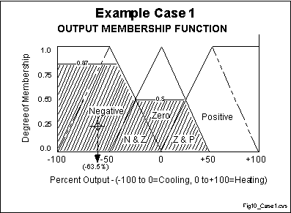
Using the rules shown in the previous slide and fuzzy centriod algorithm .
(neg_center * neg_strength + zero_center * zero_strength + pos_center * pos_strength) / (neg_strength + zero_strength + pos_strength) = output
(-100 * 0.866 + 0 * 0.500 + 100 * 0.000) / (0.866 + 0.500 + 0.000) = -63.4%
-ve sign indicates that the system will be cooled with 63.4% cooling strength.

Slide 14
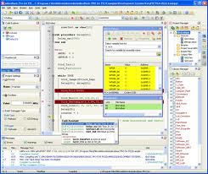
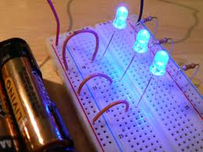
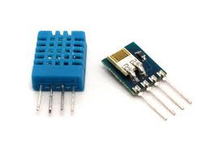
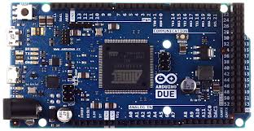
SYSTEM REQUIREMENTS
Arduino Microcontroller Board
Temperature and humidity sensors
LEDs and Breadboard
Arduino Compiler

Slide 15
REFERENCES
[1] Steven D. Kaehler, Seattlerobotics.org
[2] Srismrita Basu, Realization of Fuzzy Logic Temperature Controller, International Journal of Emerging Technology and Advanced Engineering, Volume 2, Issue 6, June 2012)
[3] R.M. Aguilar, V. Muñoz and Y. Callero, "Control Application Using Fuzzy Logic: Design of a Fuzzy Temperature Controller", University of La Laguna, Spain
[4] D.G. Schartz & G.J. Klir, "Fuzzy Logic Flowers", IEEE Spectrum, July 1992, pp. 32-35

Slide 16
THANK YOU

